Slide 1

TuX²: Distributed Graph Computation for Machine Learning
Group 18:
Hongyu Huang, Linna Hu, Jiashuo Sun

Slide 2
Content
TuX² Design
Experiments
2
3
4
5
1
2
5
Graphs for ML
MEGA Model in TuX²
Evaluation

Slide 3
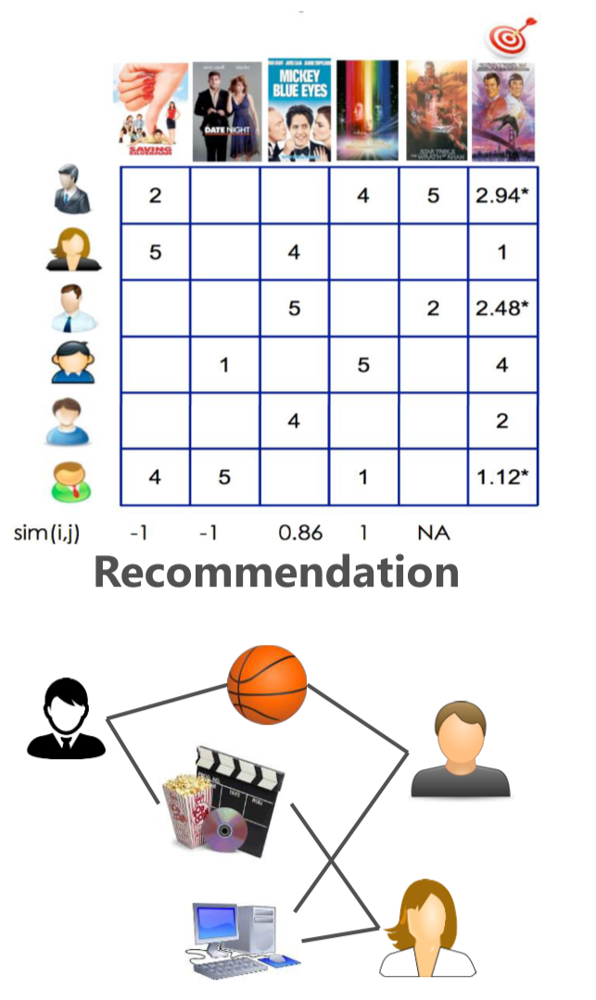
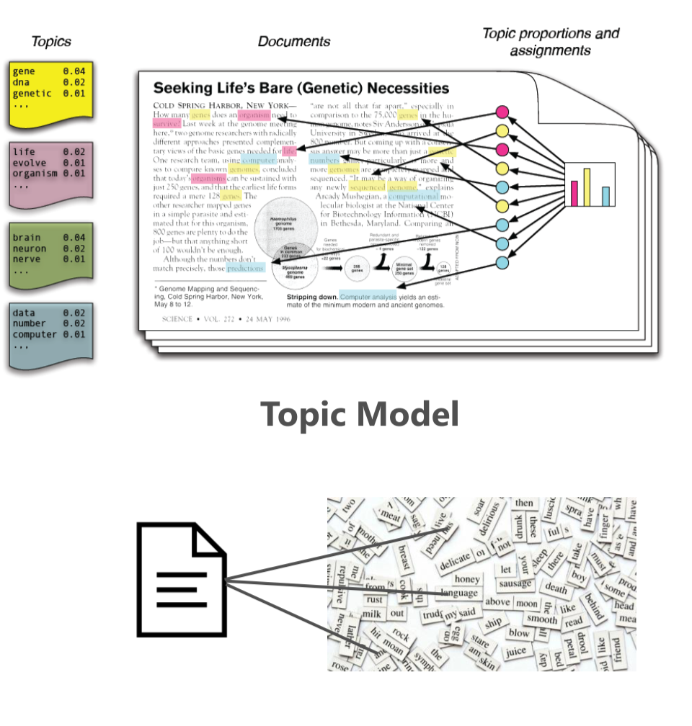
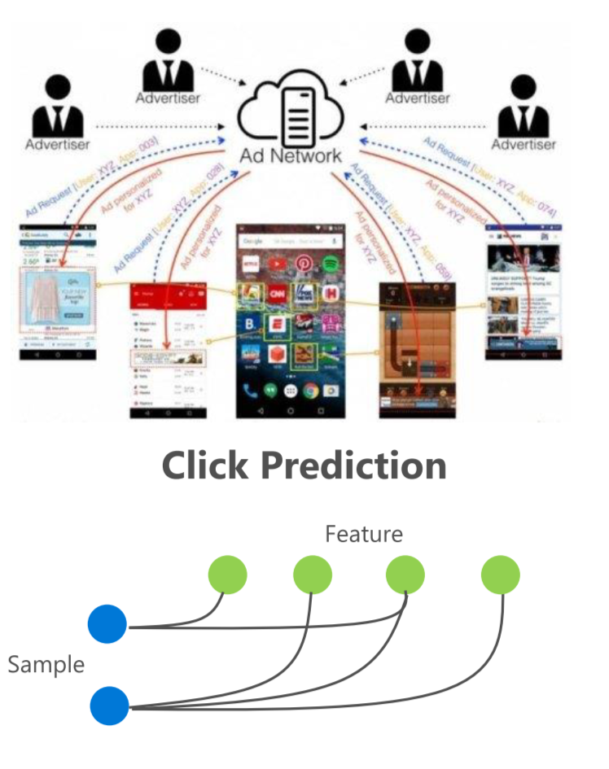
Graph Structures in Machine Learning

Slide 4
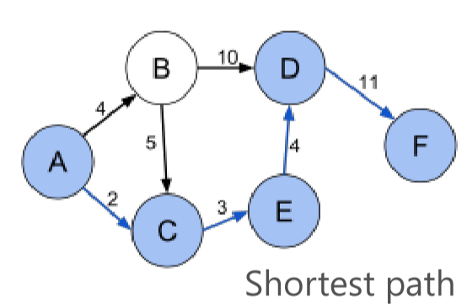
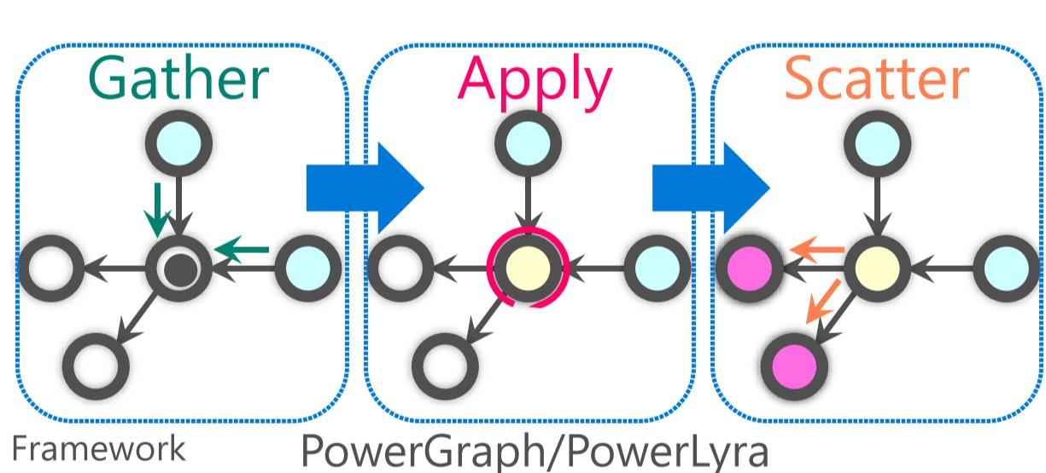
Advantages of Graph Engine
Simple Programming model (e.g. GAS)
PageRank, Shortest path, etc.
Graph-aware Optimization
Data layout [Grace, Naiad]
Partitioning [PowerLyra]
Scalability to trillion-edge
GraM
Chaos
One Trillion Edges

Slide 5
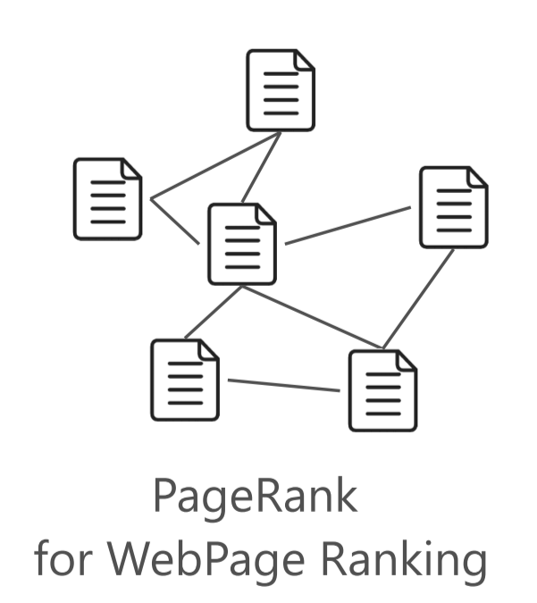
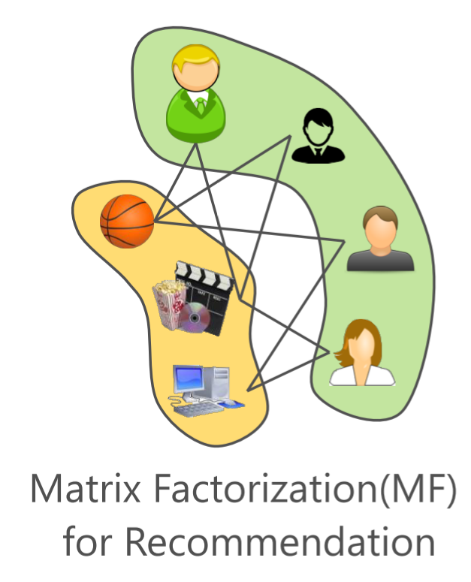
Gaps for ML on Graph Engine
Heterogeneous Vertices

Slide 6
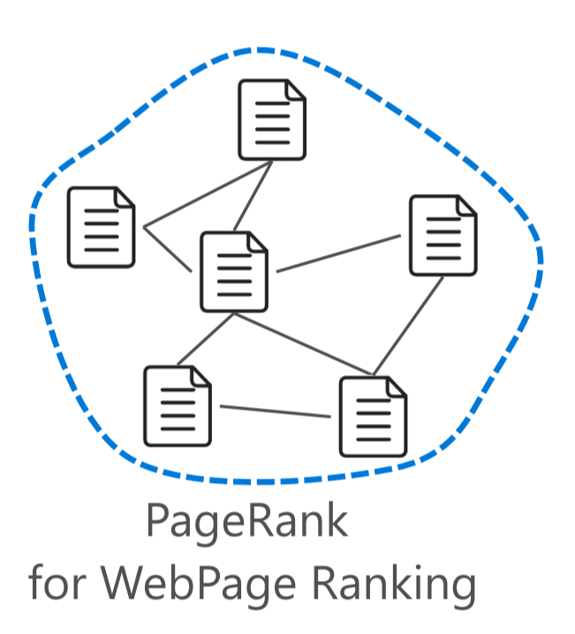
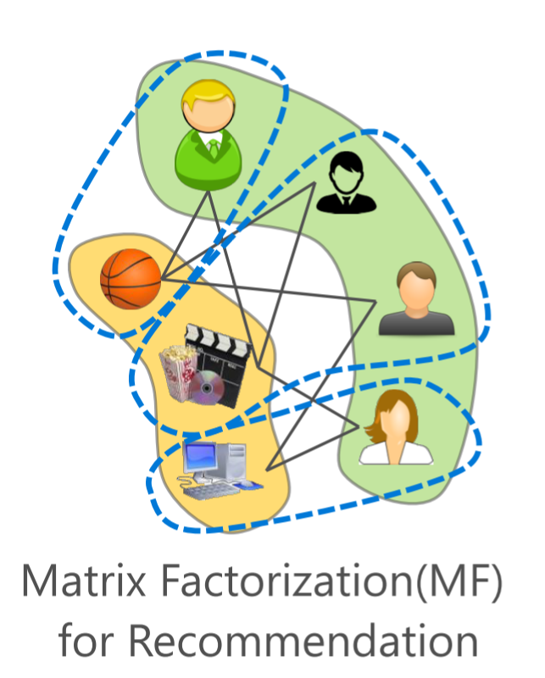
Gaps for ML on Graph Engine
2. Mini-Batch

Slide 7
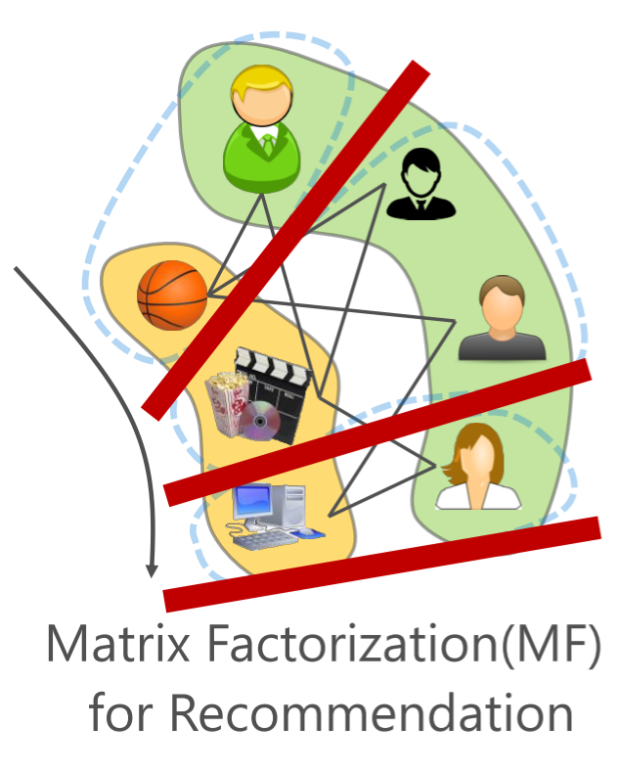
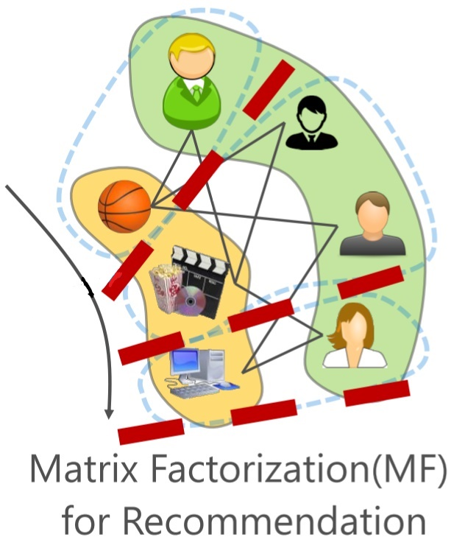
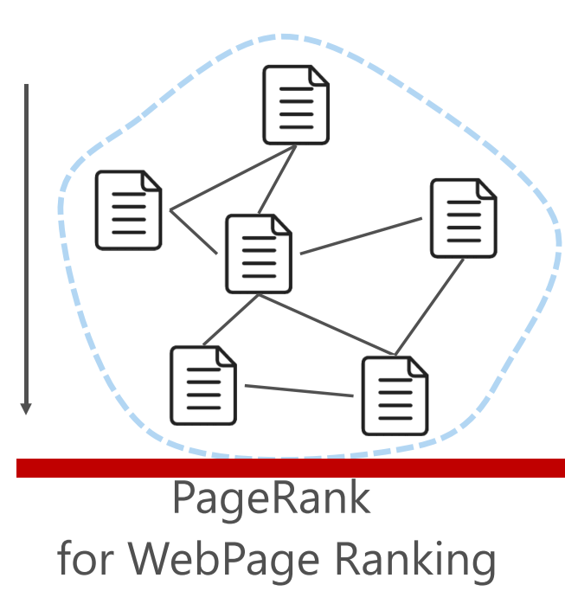
Gaps for ML on Graph Engine
3. Flexible consistency
Hard Barrier
“Soft” Barrier

Slide 8
TuX²
Bridge Graph and ML research in one system
Extend for distributed machine learning
Scheduling: Stale Synchronous Parallel (SSP) based scheduling
DataModel: Heterogeneous data model
Programming: MEGA (Mini-Batch, Exchange, GlobalSync, and Apply) graph model
Outperform both Graph and ML systems on ML algorithms
10x⬈ vs. PowerGraph/PowerLyra
Mainly due to MEGA model and heterogeneity optimization
48%⬈ vs. Petuum/Parameter-Server(P-S)
Mainly due to graph-based optimization
Notes:
To adjust those problems,,Using a unified model
Comparing with ML systems, achieve at least

Slide 9
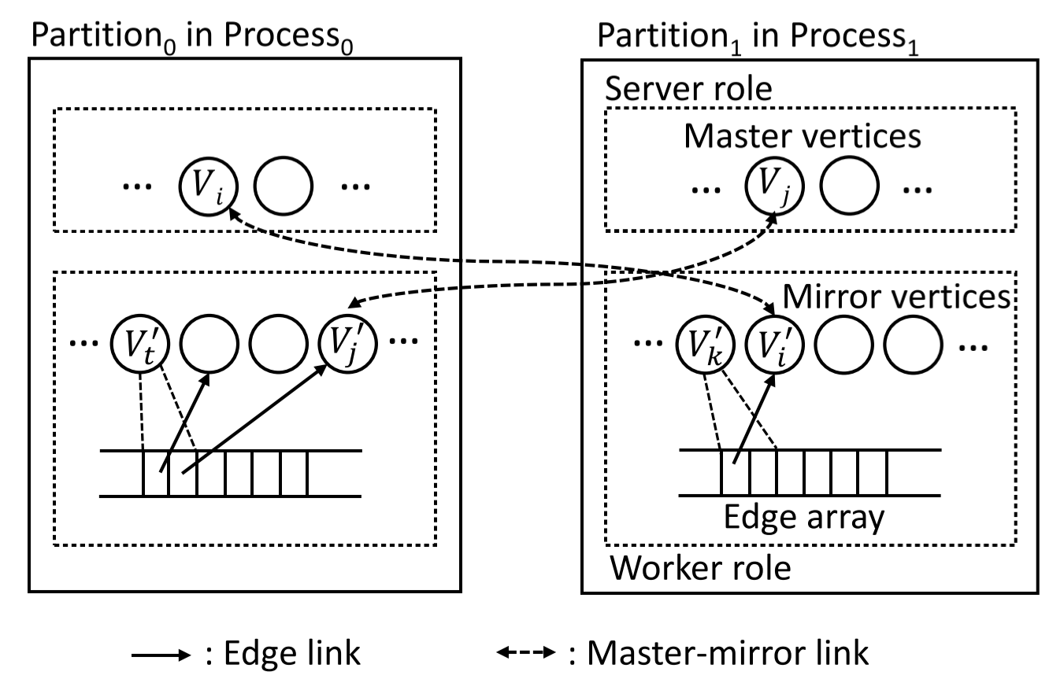
System Architecture
Overview
Vertex-cut approach
Effective for power-law graph
Naturally fits P-S model
Master vertices as the global state
Mirror vertices as the local cache
Notes:
In which edges in set of the high degree vertex
Local cached copy
In each partition, vertex and edge are in separate arraies
The destination of vertex and an index of its vertex in corresponding vertex array

Slide 10
Key Designs
Scheduling: Stale Synchronous Parallel (SSP) based scheduling
DataModel: Heterogeneous data model
Programming: MEGA graph model

Slide 11
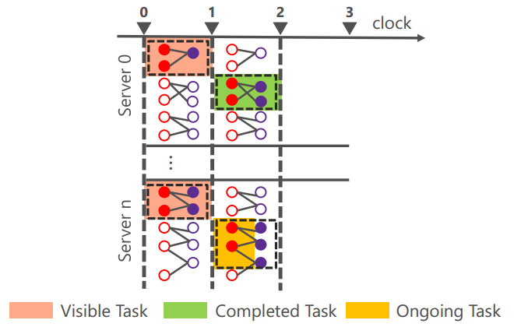
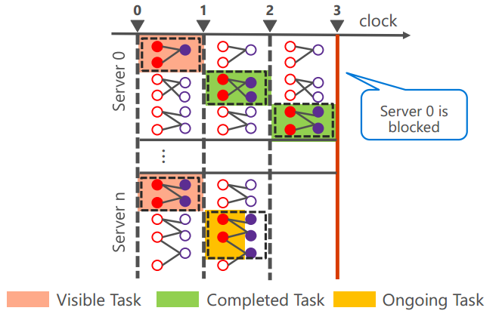
Scheduling: Stale Synchronous Parallel in TuX²
Steps:
All servers finish clock 1
Fastest server (0) finishes clock 2 and slowest server (n) is in clock 2, fastest server continues.
Fastest server (0) finishes clock 3 and slowest server (n) is in clock 2, fastest server blocks.

Slide 12
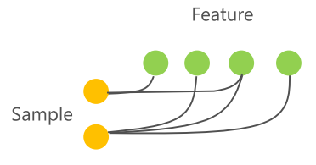
DataModel: Heterogeneous data Model
Heterogeneous Vertices:
Different properties: e.g. Logistic Regression
Benefits:
Heterogeneity for compact data structure
Heterogeneity for efficient execution
Heterogeneity for less network traffic

Slide 13
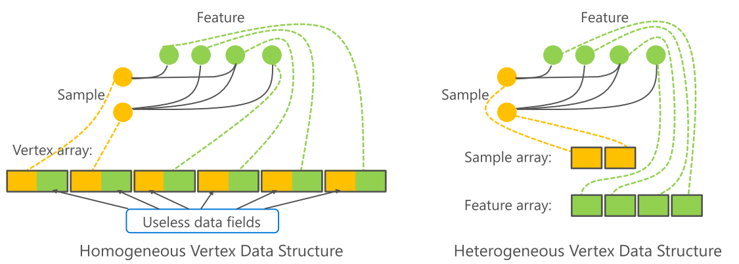
Heterogeneity for Compact Data Structure
Logistic Regression:

Slide 14
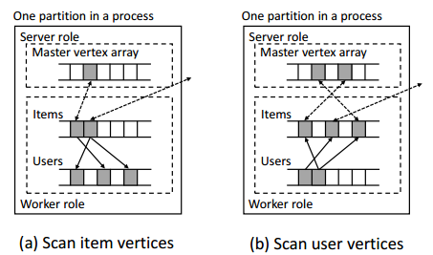
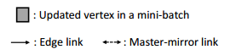
Heterogeneity for Efficient Execution
Sequential access for locally when syncing
Less overhead tracing the updated vertices

Slide 15
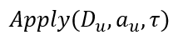
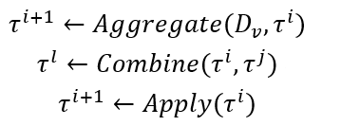
Programming: MEGA graph model
MEGA: Mini-batch, Exchange, GlobalSync, and Apply
Exchange:
Apply:
GlobalSync:

Slide 16
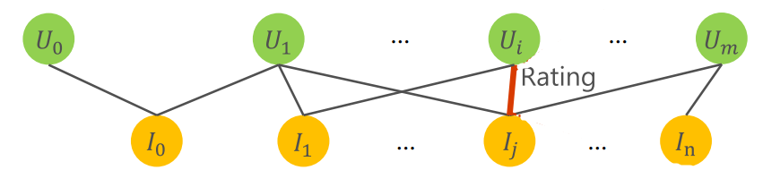
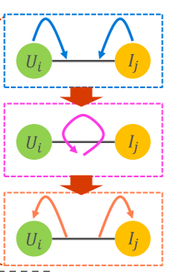
Mini-batch MF for recommendation
Exchange(v_user, v_item, edge, a_user, a_item, context){
pred = PredictRating(v_user, v_item);
loss = pred - edge.rating; context. loss += loss^2;
(a_user, a_item) += Gradient(loss, v_user, v_item); }
Apply(ver, accum,ctx) {ver.data += accum;}
Combine(ctx1, ctx2) {ctx.loss = ctx1.loss + ctx2.loss;}

Slide 17
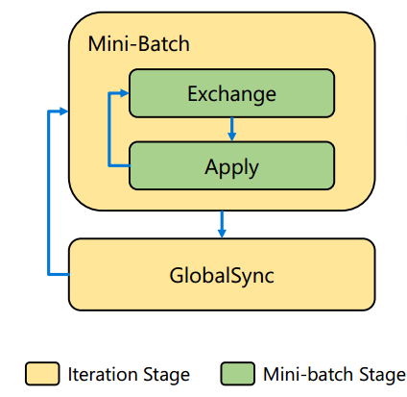
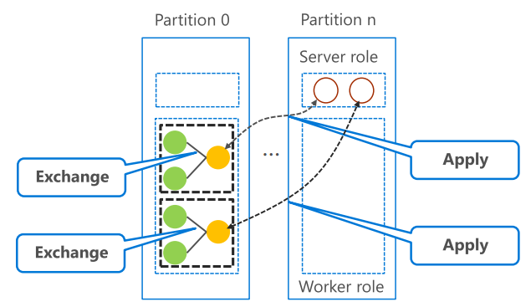
Programming: MEGA graph model
Compose stage

Slide 18
Experiment setup
Machine information
16 CPU cores, 256GB memory, 54Gbps InfiniBand NIC
Typical ML algorithms
MF,LDA,BlockPG
Large-scale dataset
UP to 64 billion edges graph
Dataset name | # of users/docs/samples | # of items/words/features | # of edges
NewsData(LDA) | 7.3MB | 418.4K | 1.4B
AdsData(BlockPG) | 924.8MB | 209.3M | 64.9B
Netflix(MF) | 480.2K | 17.8K | 100.5M
Synthesized(MF) | 30M | 1M | 6.3M
Notes:
verify design and compare to other related system on an exclusive clusters with modern architecture.

Slide 19
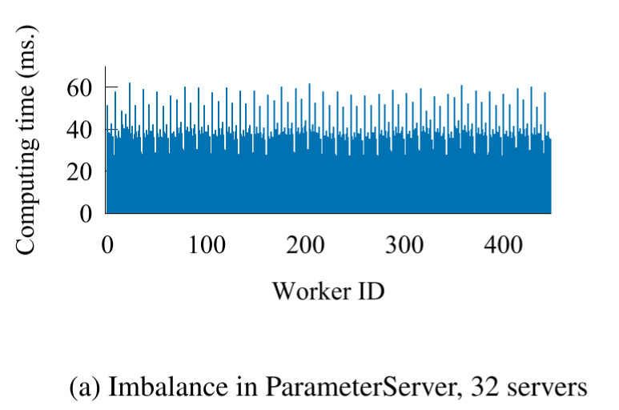
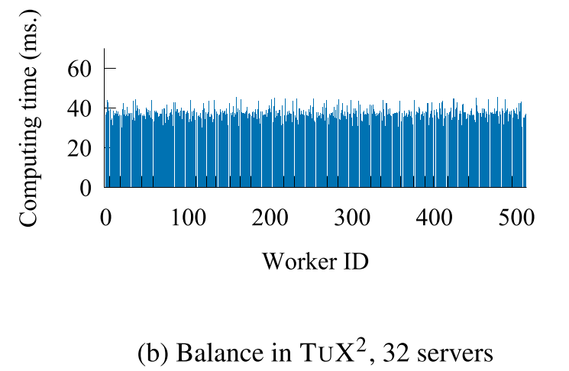
Evaluation
Compare to Parameter Server
48% improvement on 32 servers
Algorithm: BlockPG
Dataset: Microsoft private AdsData (64B edges)
Notes:
A few threads work longer than the others
TuX2 achieves balanced execution with all threads.
This great improvement is due to vertex cut, it has a balance workload

Slide 20
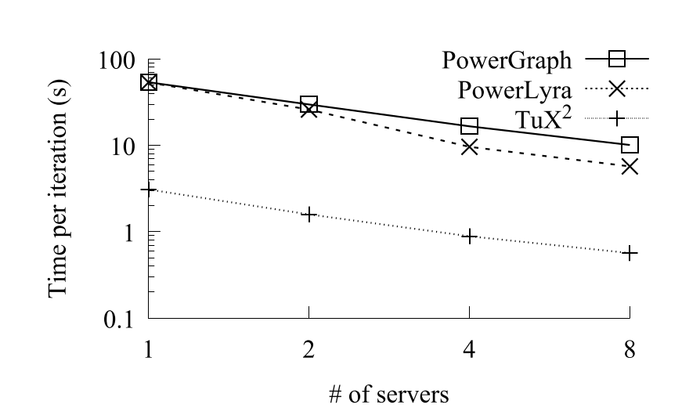
Evaluation
Compare to PowerGraph, PowerLyra
Algorithm: Matrix Factorization
Dataset: Netflix
Notes:
PowerGraph and PowerLyra support a GAS-based MF implementation.
They do not support SSP or mini-batch.
Achieves more than an order of magnitude improvement, which comes from Mini-batch and Hereogenous data layout.

Slide 21
Conclusion
TuX²: advocates the convergence of graph computation and distributed machine learning
Introduce important machine learning concepts to graph computation
Define a new, flexible graph model to express ML algorithms efficiently
Demonstrate TuX² outperform existing Graph and ML systems in representative ML algorithms respectively

Slide 22
Thank you!
Q&A

